Slide 1
Virtual Venom: Electronic Issues and Discovery in Family Law Cases
Annette T. Burns, J.D.,
Phoenix, Arizona
Bryan Altman, www.OurFamilyWizard.com
June 8, 2012

Slide 2
Social Networking
Facebook
Myspace
Twitter
LinkdIn
Second Life --- really?
Google +
Orkut
http://en.wikipedia.org/wiki/List_of_social_networking_websites
Notes:
This is just an overview to give an idea of how prolific social networking is and what it means to our practice. It is everywhere, and it is much bigger than facebook.

Slide 3
Survey
How many of you are on facebook?
LinkedIn?
Twitter?
One out of 8 couples married in the US in 2009 met via social media.

Slide 4
Facebook
There are over 845,000,000 active users of FB; about half a billion sign on to FB every day. FB is expected to pass the 1 Billion mark total user mark by August 2012 at the latest.
FB is integral, not optional, to political campaigns.
The largest user group remains 18-25 year olds, but there are still over 15M users age 45 or older, and the growth rate for 45 years and older runs about 4%.
Largest growth demographic is women age 55-65.

Slide 5
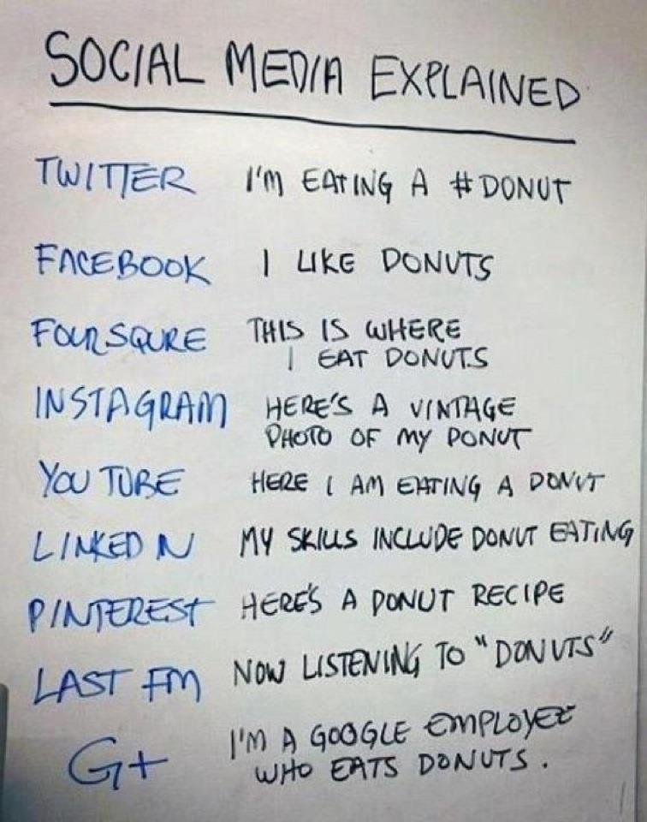

Slide 6
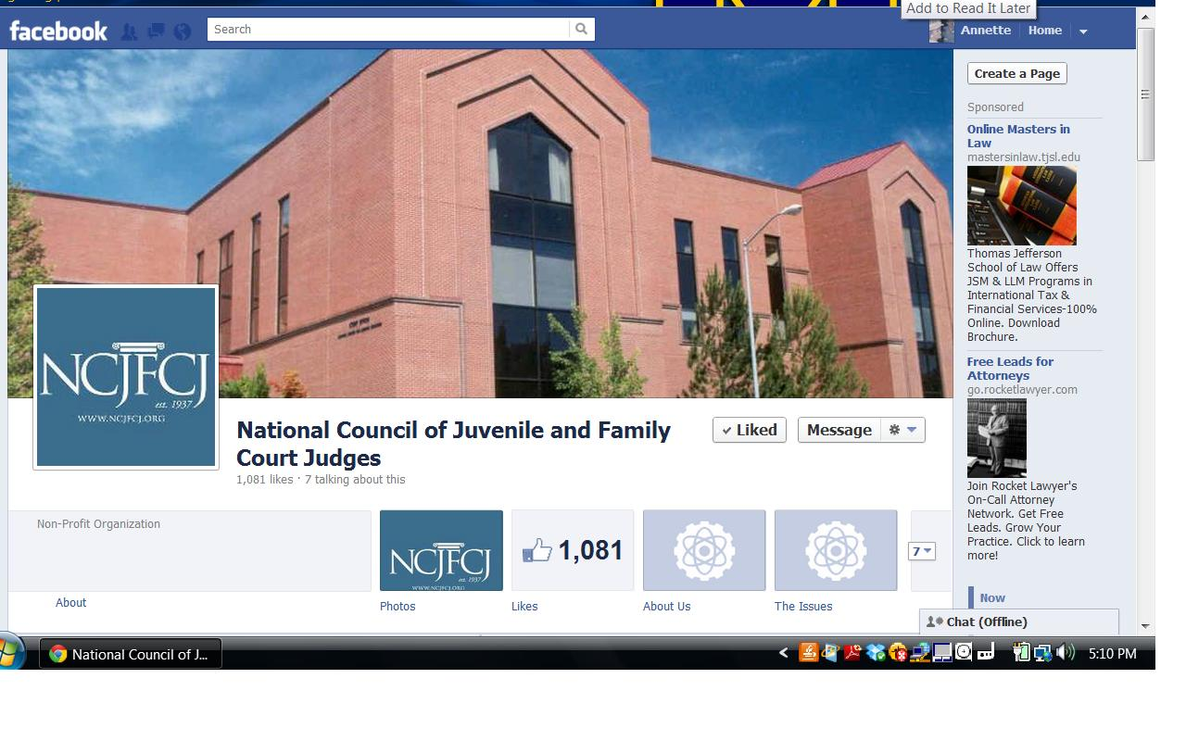
Facebook Fan Page

Slide 7
LinkedIn
The professional social network site – 70,000,000 members
Resume
Recommendations
Blog and Twitter accessibility
Groups
LinkedIn cute cat pictures, ironic comments, jokes

Slide 8
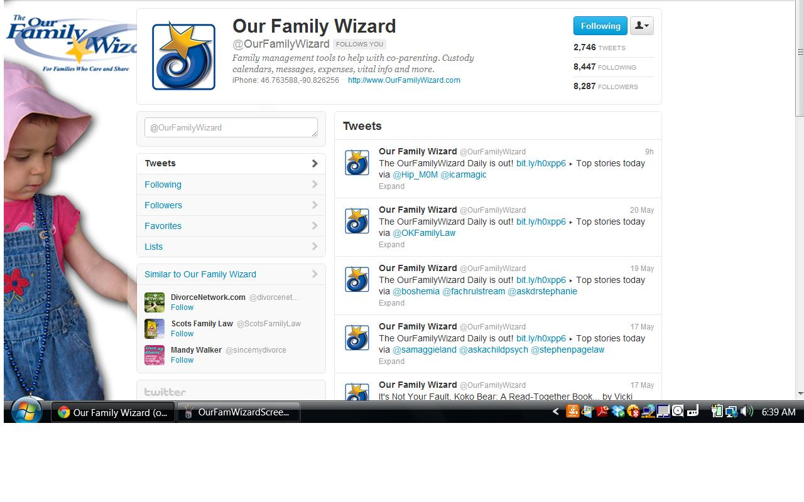
Twitter for interesting information

Slide 9
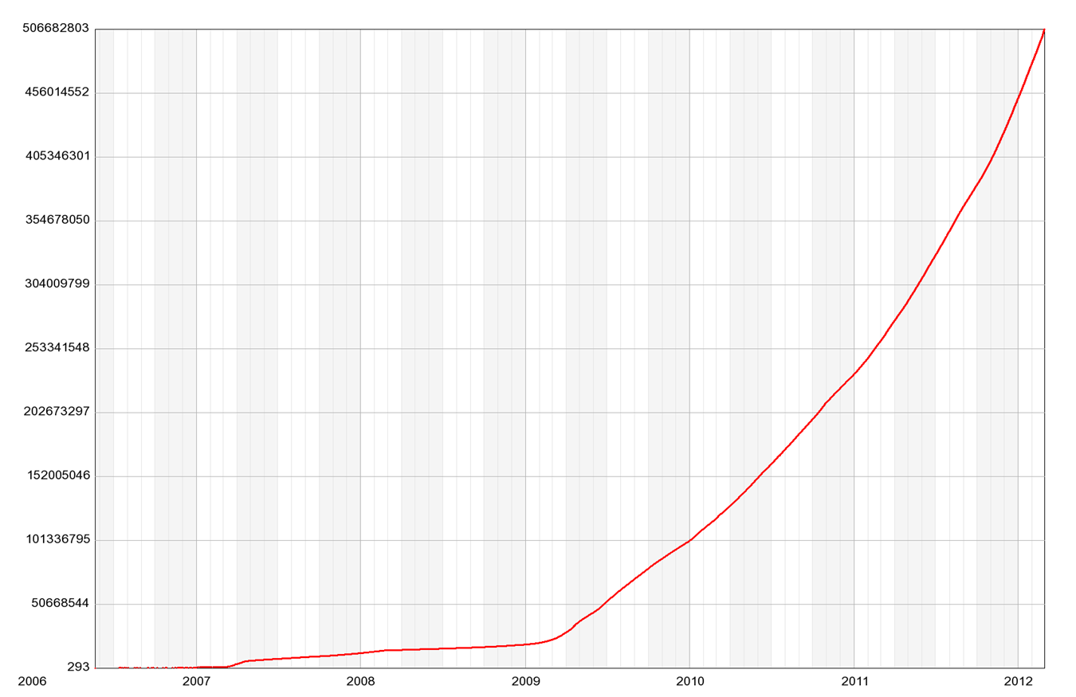
Twitter Use Skyrockets

Slide 10
Problems with Social Networking for Litigants
Posting inappropriate information / photos
Information can be about where the person was
Wrong timing – supposed to be with kids but instead on facebook
Photos can be in a bar or of their significant other’s children (ex of significant other usually does not like that)
Photos of highly inappropriate parenting
Finding old flings – one law firm says that 20% of divorces cite facebook in the petition. http://www.thefirstpost.co.uk/57742,news-comment,technology,facebook-causes-one-in-five-divorces-says-law-firm
AAML survey re facebook February 2010

Slide 11
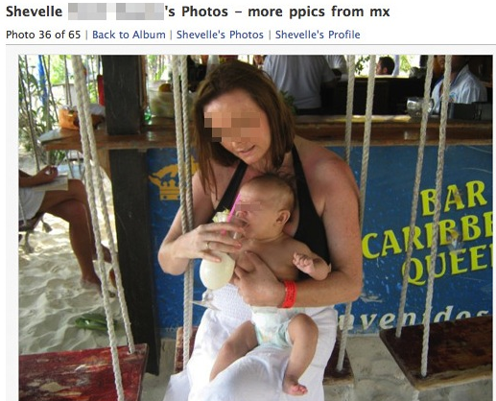

Slide 12
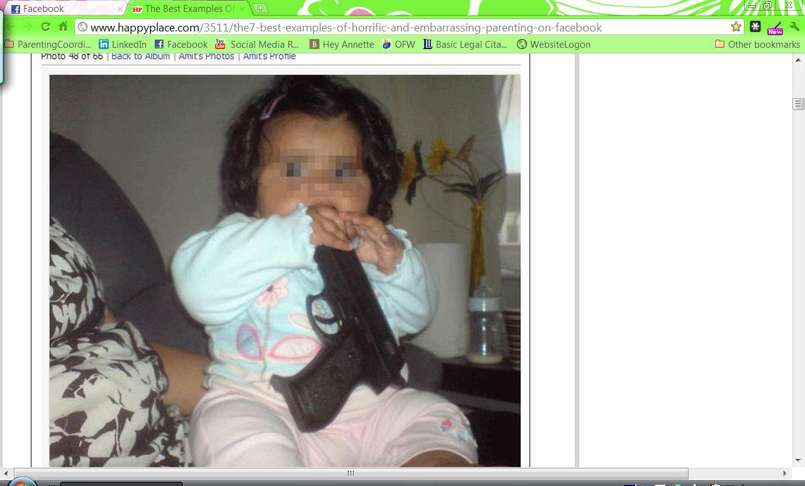

Slide 13
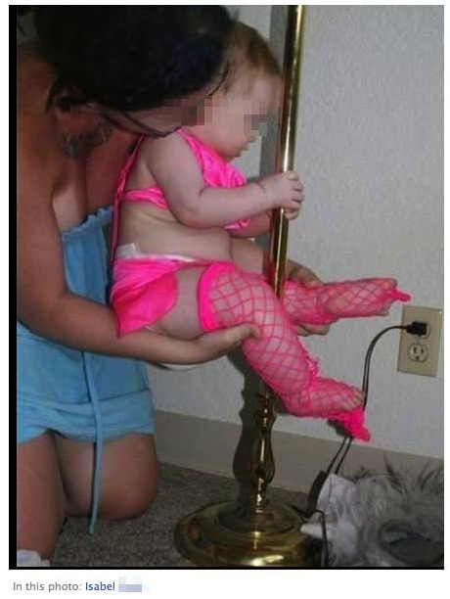

Slide 14
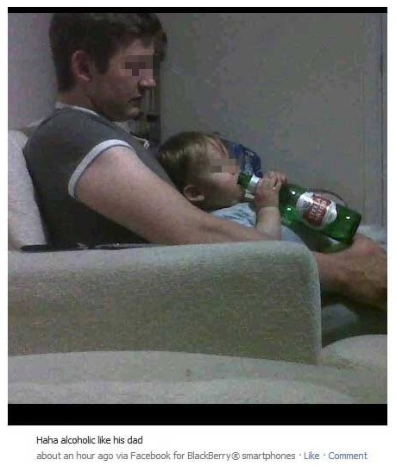

Slide 15
What else have litigants done?
Posting nude pictures of an ex.
Blaming the phone company for the breakup: http://news.nationalpost.com/2010/05/17/woman-sues-rogers-wireless-inc-for-ruining-her-marriage/

Slide 16
Stupid Facebook Tricks
This is why you never ever accept FB friend requests from people you don't know
Watch me abuse my child on facebook:
http://www.cnn.com/2011/12/21/justice/facebook-father-battery (December, 2011) "This is wut happens wen my baby hits me back. ;)"

Slide 17
Problems with social networking for Professionals
Ethics!
Updating at problematic times, regardless of what is actually posted; where are you supposed to be?
Privacy issues: adversarial litigants finding out about your personal life
Getting the relevant information into evidence;
Political views --- why?
Did we mention ethics?

Slide 18
In the News
Hey don’t worry: http://volokh.com/2010/02/11/hey-dont-worry-the-judge-is-my-friend/
Florida Supreme Court said that judges and lawyers may not be friends on facebook.
Missouri said, briefly, that teachers and students can’t be facebook friends. Unconstitutional!
What about an organization like AFCC?
“The practice of lawyers and judges actually being friends, of course, can’t be prohibited; if lawyer Jones and Judge Smith played golf last weekend, well, bully for them. And the fact that they did so in a public place and could therefore show up in the newspaper wouldn’t give anyone grounds for complaint. But there is something different about being listed as a “friend” on a publicly-accessible website.”

Slide 19
More in the News
ABA Journal: Lawyers just can’t help being stupid. Emailing pictures of a decedent from a wrongful death case? Trash-talking judges and clients, giving out too much information about a case in progress.
Above the Law: Divorce lawyers turn facebook into case-winning goldmine
Divorce lawyers catch cheaters on Facebook

Slide 20
Technology in the evaluation and the courtroom
What about the admissibility of all these other social networking posts, messages, exchanges, photographs;
Emails between litigants as trial exhibits has skyrocketed;
Use of emails as documentation of parenting abilities in evaluations : at least evaluators are not constrained by strict admissibility standards.

Slide 21
Use of Internet-Posted Items as Evidence in Court
PDF the page/ file, to preserve the exact appearance of the page, including the URL where the image was located, and the DATE it was preserved. Remember that it CAN be easily changed/ deleted, so immediate preservation is vital.
Adobe Acrobat is the standard for creation of files.

Slide 22
Preservation of the web page
Open up the page
Convert to PDF using Adobe Acrobat (“print to Adobe” is the choice)
Save the PDF file
You now have preserved that page for posterity, even if it’s changed later.

Slide 23
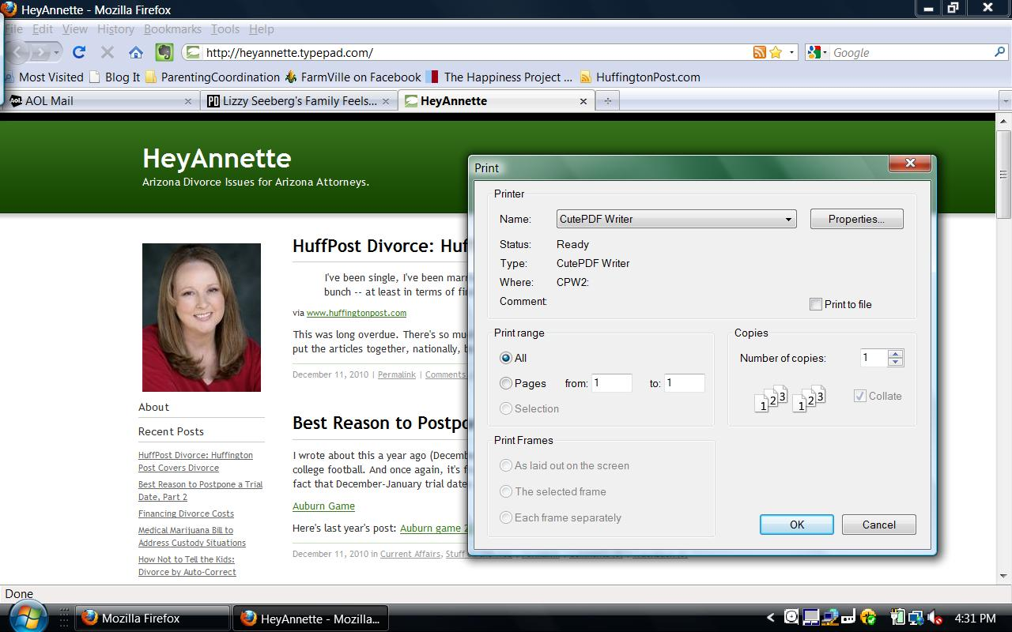

Slide 24
But can you get it admitted?
Is the Evidence Relevant?
Is it Authentic?
Is there a Hearsay Issue?
Are there any other Evidentiary Rules to worry about?

Slide 25
Family Privacy Orders
Parental Controls of Home Computers.
Both parents will use parental controls on all computers which are accessible to the minor children. In the event an adult’s computer does not have parental controls, it shall be password protected with a secure password unknown to the child. Parental controls shall include content and user time limitations. Parents shall only use secure sites to download children’s games and shall review the content prior to allowing the child to participate in any internet game.

Slide 26
Child’s Participation in Facebook and other other interactive social networking internet activities.
The child may participate in obtaining these accounts, upon agreement by both parties, but (each, or specify which) parent will have the child’s password for all accounts. The monitoring parent shall be able to completely monitor, and, if necessary, shut down the account.
All accounts regarding the child shall be private accounts and shall not be open to public use. The parent(s) will monitor periodically to determine whether the child’s “friends” are appropriate, whether appropriate privacy guards are in place for the account, and shall block and unfriend inappropriate content.

Slide 27
Use of photographs of children on the internet.
In the event either parent desires to post photographs of the children on a social networking or other internet site, that parent will maintain the privacy of the site by blocking unknown persons, maintaining the site as “Private” or “friends only”.
Any photograph of the child shall be appropriate for age and content and shall not include any nudity or partial nudity. The parent will take any other necessary security precautions as may be required from time to time.

Slide 28
Telephone for minor.
A telephone for the minor child shall not be provided by either parent prior to the child’s tenth (10th) birthday. Any telephone provided for the child from age 10 until age 12 shall be restricted to the telephone numbers the parent(s) elect, to include both parents as well as 911.
After age 12, the minor’s phone may be unrestricted (upon agreement of the parties ) and the parent providing the telephone shall allow unrestricted text messaging with the other parent. In the event the minor requests a Twitter or other microblogging account, the parents shall strictly monitor said account for content appropriateness.

Slide 29
Inappropriate Internet Activities.
The child shall not be exposed to any pornography in either parent’s home or in any other situation or location in which the parent is aware that exposure to pornography is likely to occur. This prohibition includes the use of avatars to enter internet virtual worlds such as Second Life or others.
The parents will monitor any virtual interactive games the child may be involved in for appropriate content and activity. If the parent cannot or does not do so, the site will be removed from the minor’s participation by an appropriate computer parental control.

Slide 30
Notification to each parent. Each parent will notify the other at any time there is a change to the child’s accounts, internet activities or other significant event regarding the child’s privacy or potential invasion thereof.
Parents will ensure each parent’s significant other/ spouse is made aware of these family privacy orders and shall monitor the use of the child’s privacy information (including photographs) by the significant other/ spouse.
New Issues. The parents will maintain communication about any new developments on the internet or internet related devices which may negatively impact the minor and will cooperate with each other to address any such issues.

Slide 31
Technology for Good - Litigants
Long distance visitation and Skype
www.Ourfamilywizard.com
Divorce / Family information online
Text messaging / emailing instead of talking face-to-face or even over the phone
Google
Documents
Calendar
Email account both parents use and give the school

Slide 32
Sample Internet privacy orders available in Word at HeyAnnette.com Blog

Slide 33
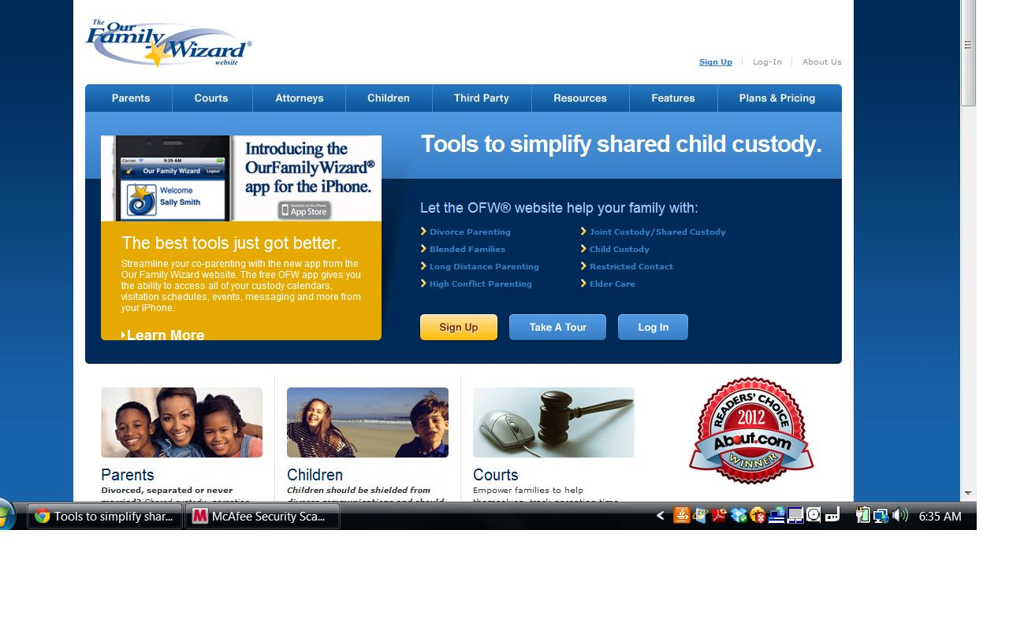

Slide 34
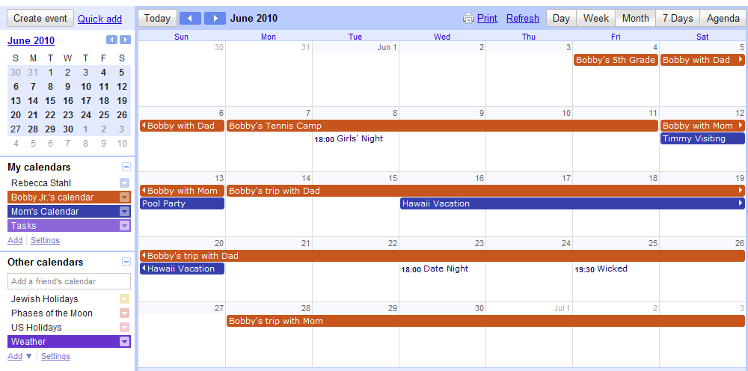
Google Calendar – Mom’s View

Slide 35
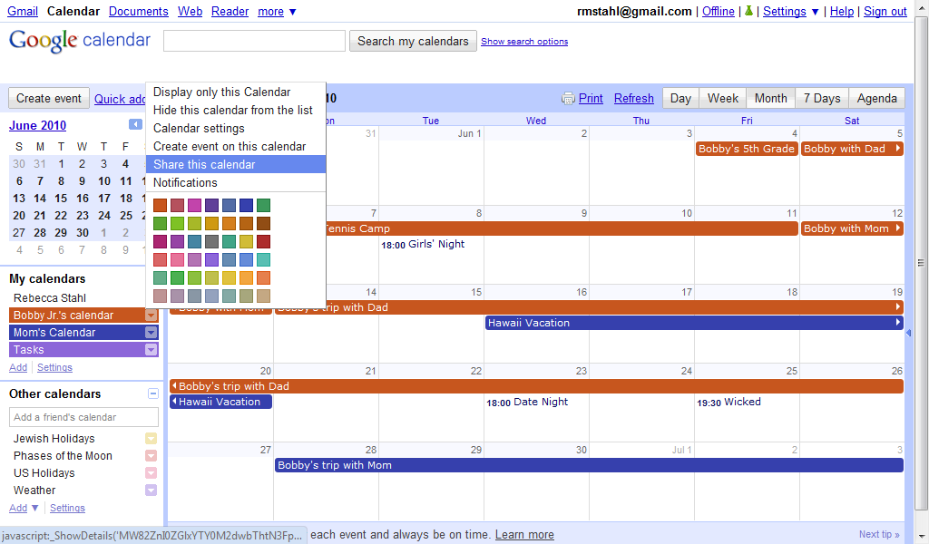
Google Calendar - Sharing

Slide 36
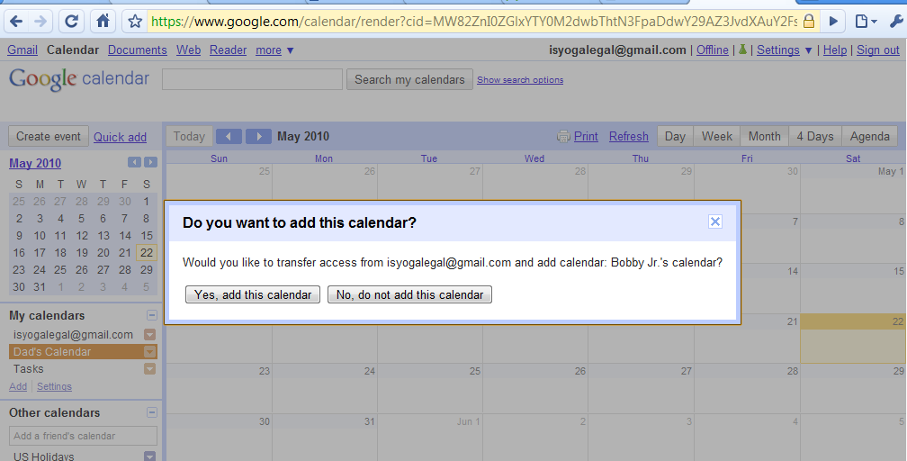
Google Calendar – Accepting Invitation

Slide 37
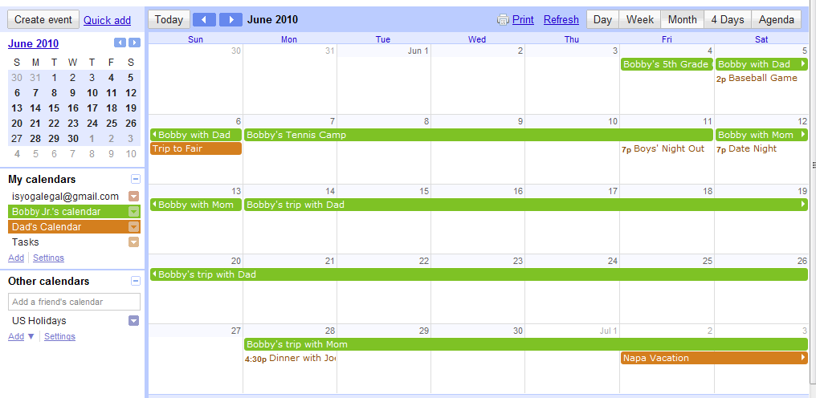
Google Calendar – Dad’s View

Slide 38
Technology for good – Professionals: Convenience, learn, teach, and promote
Email: Paperless, convenient, fast (is it safe?)
Rules of e-mail engagement for litigants and PC clients
Websites: Make your website user-friendly
Facebook fan pages: are they for you?
Blogs: learn about family law or promote your business
Twitter: some groups send links to articles and new case law
RSS Reader (like Google reader): Have important posts sent to you

Slide 39
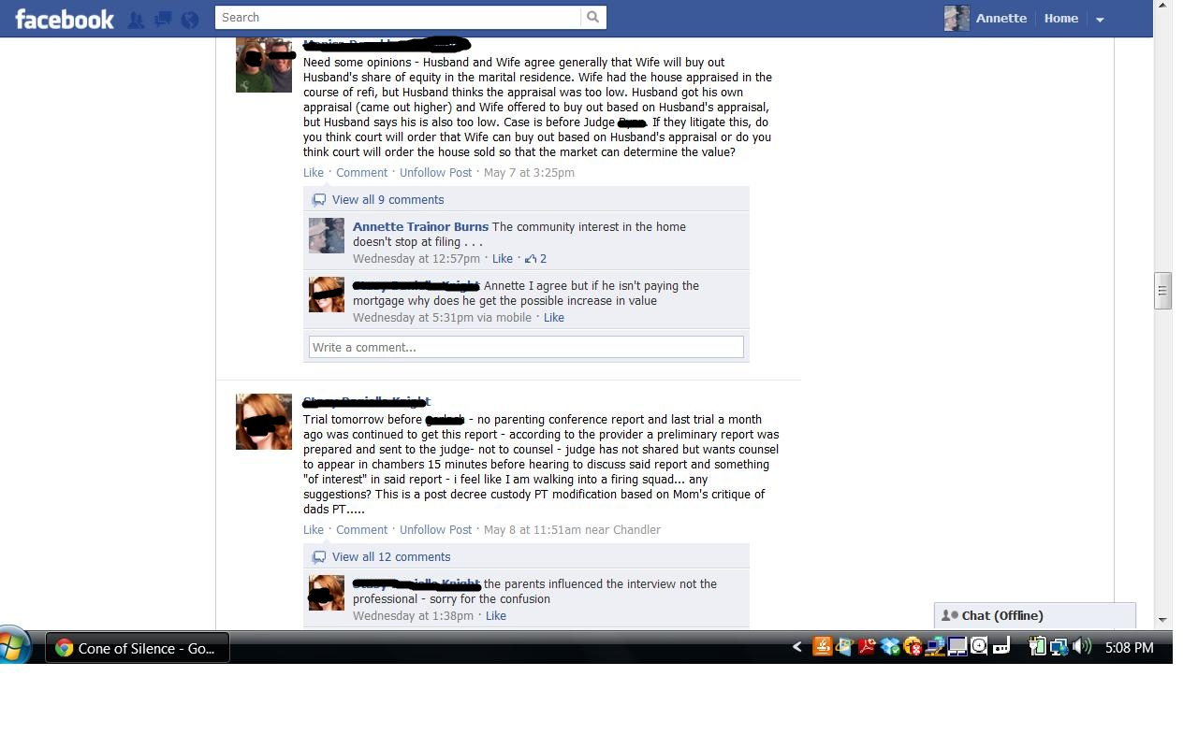

Slide 40
Email rules of engagement for Parenting Coordination Clients
Email Instructions for Parenting Coordination Cases
SPECIFY AN EMAIL ADDRESS.
BRIEF EMAILS.
SUBJECT LINES.
FUTURE-ORIENTED ONLY.
RESPECTFULNESS.
COPIES TO PC.
RESPONSES.
NEW SPOUSES
FINANCIAL ISSUES.
TEXT MESSAGING.

Slide 41
Adobe Acrobat Professional: Save your sanity and your practice
The horrendous mass of emails from PC, evaluation and litigation cases can be saved to one convenient PDF file that’s available for perusing, including attachments preserved in their original format.
Turns an outrageous and never-ending list of emails into something searchable and useable: one PDF file with a whole group of emails, organized for your use.

Slide 42
Email Guidelines for Parenting Coordinators (our own use)
Email is safe . . . when it is
Civility remains important
Emails are written communications
Say hello at the beginning and use a salutation at the end; TEACH them
Answer your emails promptly . . . but use some thought
What is your time worth? Inform clients how they will be charged for your email use

Slide 43
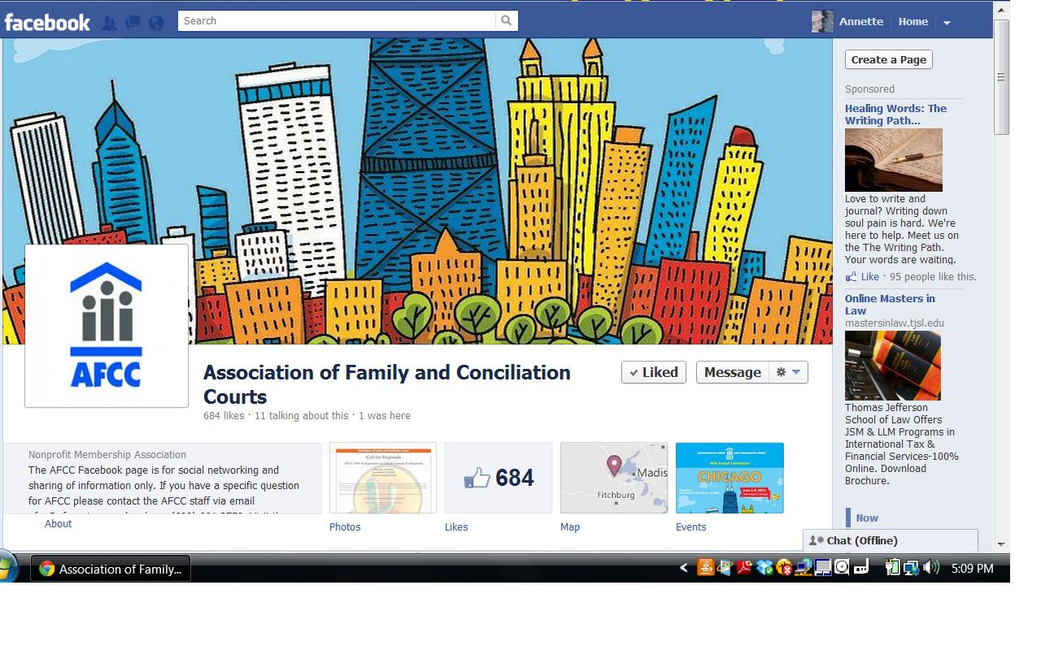
Facebook Fan Page - AFCC

Slide 44
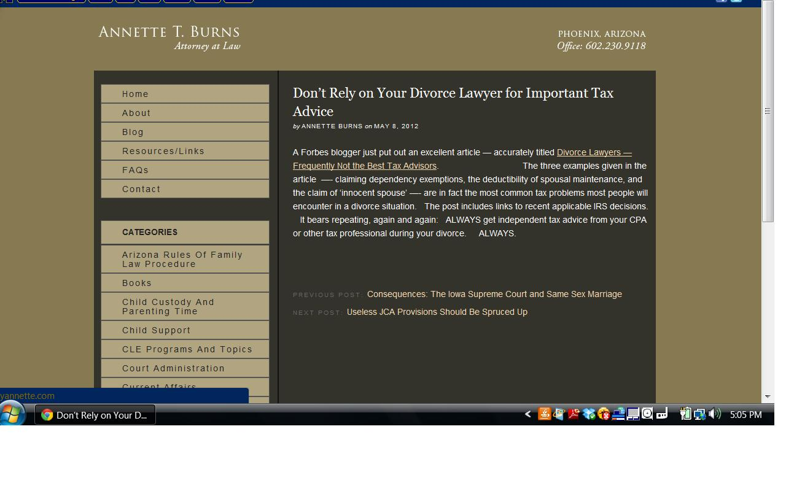
Blogs

Slide 45
Useful Family Law Blogs
Annette Burns (parenting coordination issues and updates on AZ): http://heyannette.com/blog
Family Law Professors Blog (for interesting news / articles about family law): http://lawprofessors.typepad.com/family_law/
Jeanne Hannah’s (Michigan attorney) http://jeannehannah.typepad.com/

Slide 46
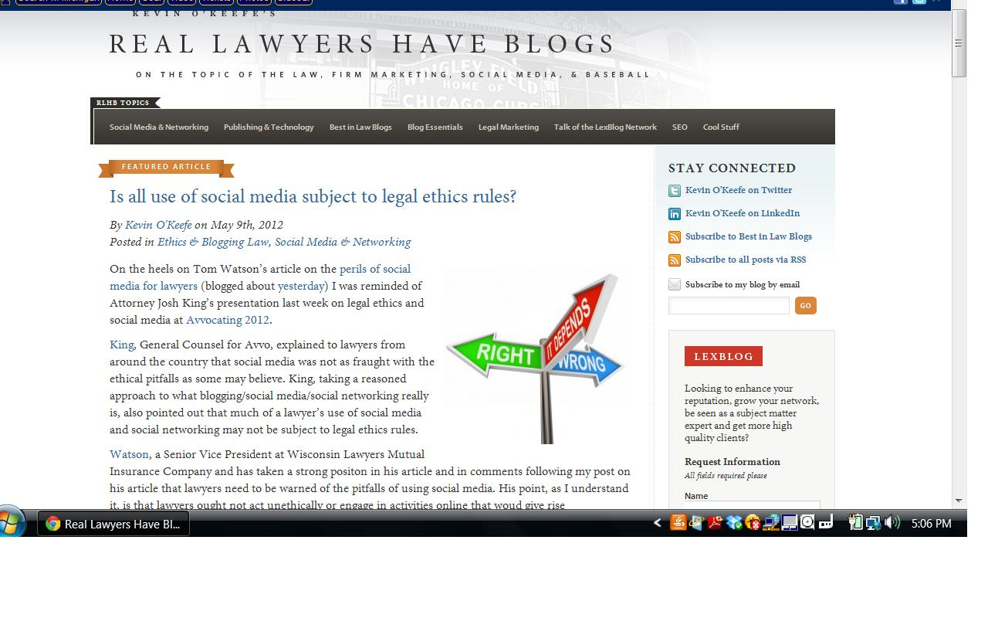

Slide 47
Questions?
annette@btlawyers.com
www.HeyAnnette.com

Slide 48
Web Page with Information www.HeyAnnette.com

